Slide 1

Semantic Search engine for (Obamacare) healthcare plans
UCB MIDS Team
Healthcare Finder

Slide 2
UC Berkeley Team
Safyre Anderson think2wice.saf@gmail.com
Konniam Chan konniam.chan@berkeley.edu
Ron Cordell ron.cordell@gmail.com
Christopher Dailey <christopher.dailey@gmail.com>
Marjorie Sayer 3marjorie14@gmail.com,
Dr. James G. Shanahan <james.shanahan@gmail.com>

Slide 3
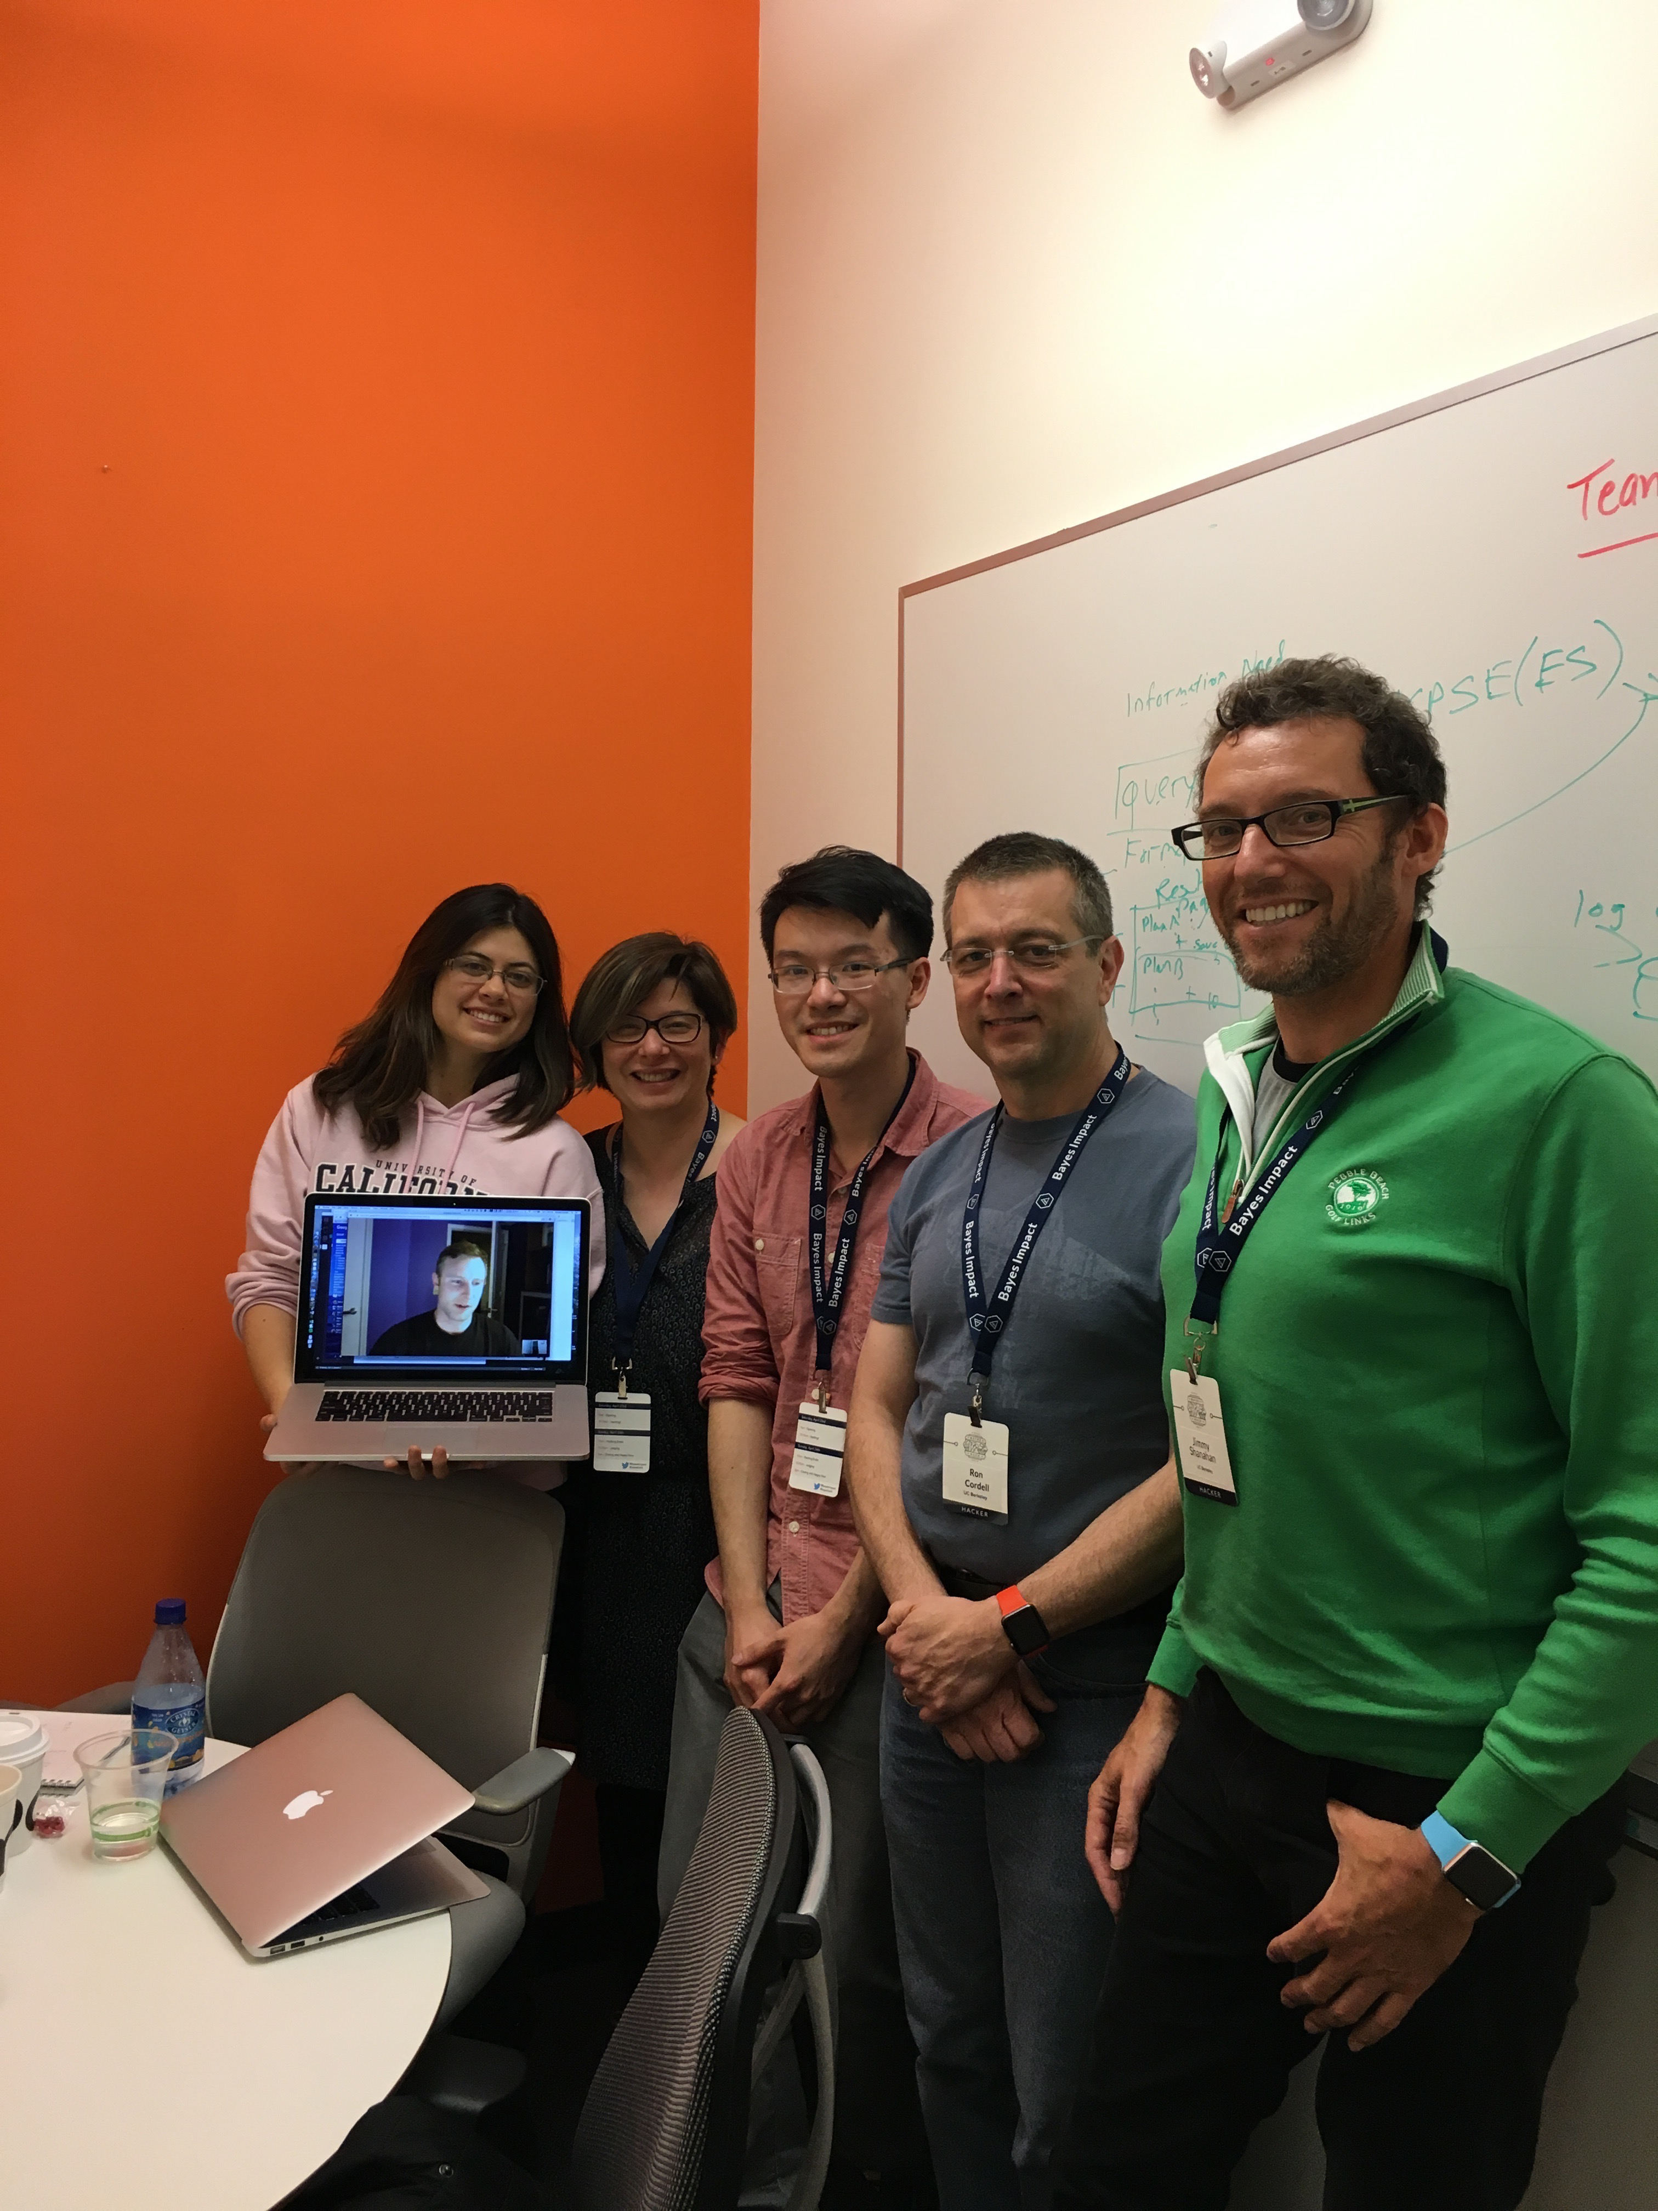

Slide 4
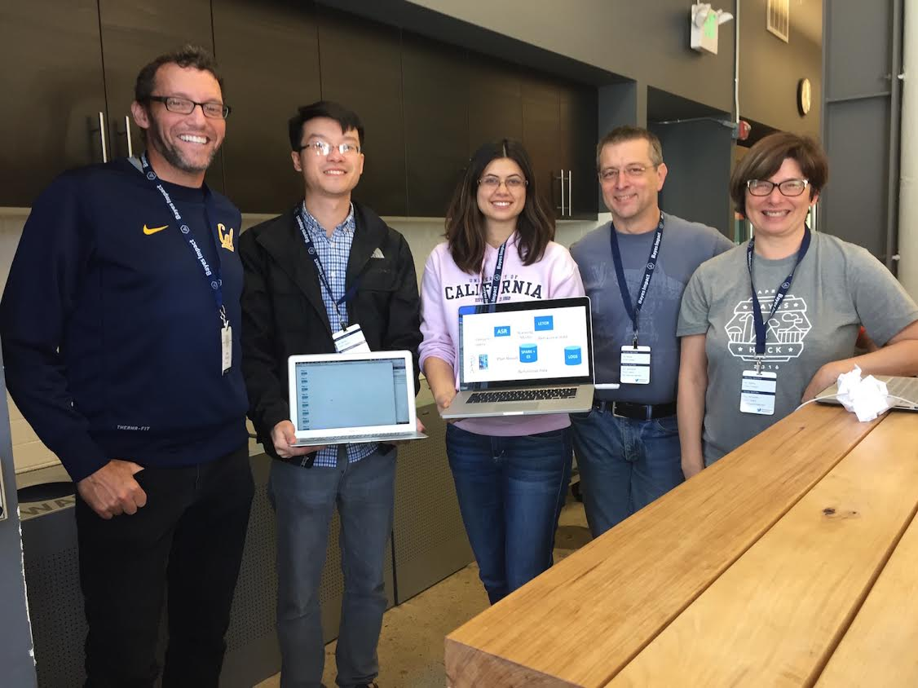

Slide 5
Thanks to
David Portnoy, EIR, US Department of Health and Human Services
Bayes Hackathon Organizers
Kirtan Upadhyaya <kirtan@bayesimpact.org>

Slide 6
Obamacare Search Engine
Due to the insurance related provisions, 6 in 10 Americans can get covered for $100 or less on the Health Insurance Marketplace, with the average plan costing just $82 after Premium Tax Credits in 2014. As of March 2015, the net cost of ObamaCare is projected to be $1.207 trillion over the 2016 – 2025 period*.
$120 Billion per year ObamaCare (ObamaCare)*
Business opportunity:
$12Billion for marketing and advertising
Search engine for healthcare plans (speech recognition and faceted search)
Generate leads for healthcare plans through sponsored search
*[http://obamacarefacts.com/costof-obamacare/]

Slide 7
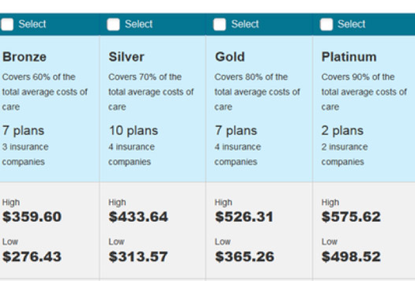

HHS ACA: A mass of information to process
Problem:
Choosing an ACA plan is difficult
Providers are not always in network
Information Overload

Slide 8
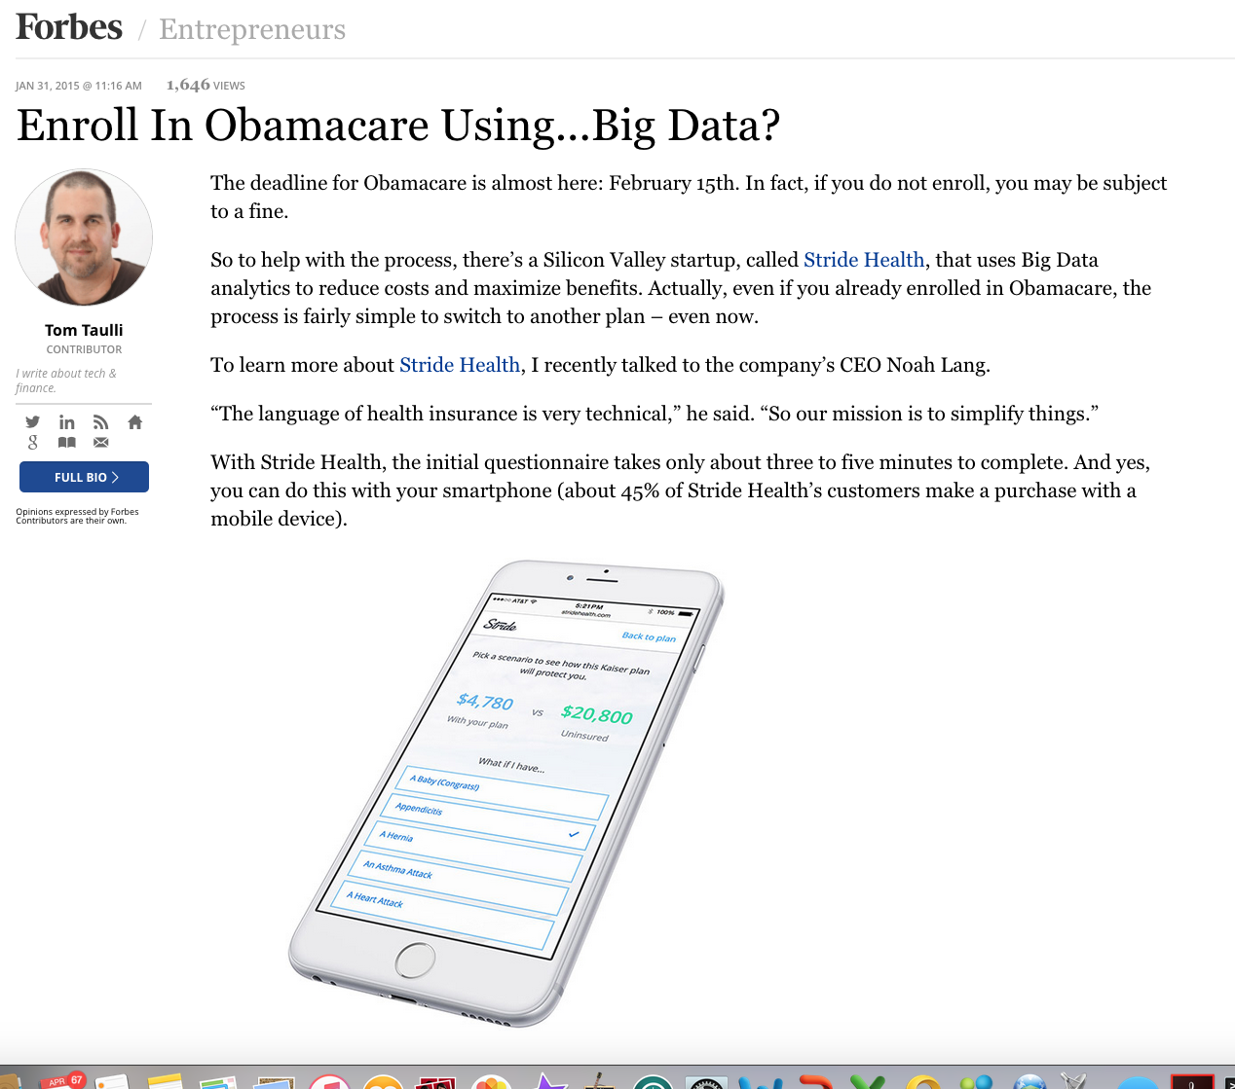

Slide 9
Pain Points with existing Solutions
Healthcare.gov
Long process, entering sensitive data
A chosen plan has a good chance of not including the doctor you want
Lists qualified providers
Information brokers
Easier interface; doesn’t require private credentials; earns payment for plan referrals
A skin on existing data; does not address patient concerns, does not learn rankings from input

Slide 10
The Solution
Semantic Search: Ranking + Facets
Google + Amazon
Dynamic forms that adapt to semantics
Third-party data from multiple sources used for ranking
Machine Learning and Classification
A response form that invites users to interact facets of their search
A machine learning engine that predicts Plan suitability from clickstream data

Slide 11






Combined Publicly Available Datasets
"plans" : {
"properties" : {
"marketing_url" : {
"type" : "string"
},
"marketing_name" : {
"type" : "string"
},
"last_updated_on" : {
"format" : "dateOptionalTime",
"type" : "date"
},
"plan_id_type" : {
"type" : "string”
…
…
}
}
},

Slide 12
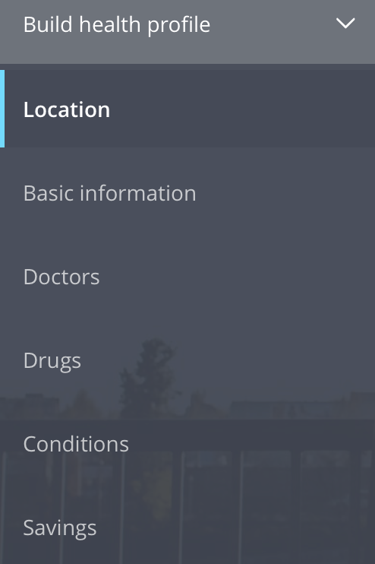
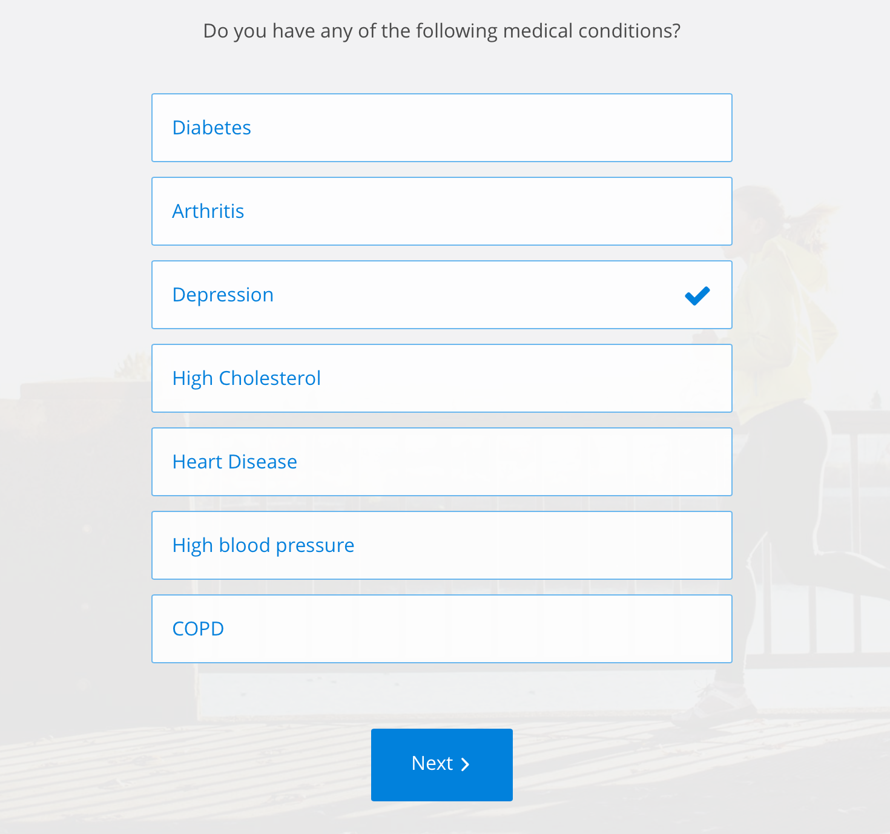



Innocent Bayes Standers
Are you interested in the following care?
About your care
Search
Build Health Profile>
Location
Location
Clinical Trials
complete
Basic Info
complete
Doctors
Acupuncture
complete
Zip Code
Drugs
complete
Salary
At home Physical Therapy
Conditions
complete
Plan data
Correlations
Savings
Marital Status
complete
Meditation
<family>
Single
Married
Divorced
Care Directives
<location>
Add
“I’m a housewife in Minnesota with a son who has Aspergers”
Number of dependents
Holistic Health
Trending:
Physician 1
Type II Diabetes Prevention
<family-child>
<diagnosis>
Physician 2
Ergonomics Class
Occupational Therapy
Preference options
Condition 1
Smoking Cessation
Medication 1

Slide 13
LETOR
ASR
Ranking
Model
Semantic
query
Behavioral data
SPARK + ES
ES
LOGS
Plan Result
Behavioral data

Slide 14
Innocent Bayes Standers
Are you interested in the following care?
About your care
Build Health Profile>
Location
Location
Clinical Trials
complete
Basic Info
complete
Doctors
Acupuncture
complete
Zip Code
Drugs
complete
Salary
At home Physical Therapy
Conditions
complete
Savings
Marital Status
complete
Meditation
Care Directives
Single
Married
Divorced
Add
Number of dependents
Holistic Health
Trending:
Physician 1
Type II Diabetes Prevention
Physician 2
Ergonomics Class
I’m worried about my chronic heartburn.
Preference options
Condition 1
Smoking Cessation
Medication 1

Slide 15
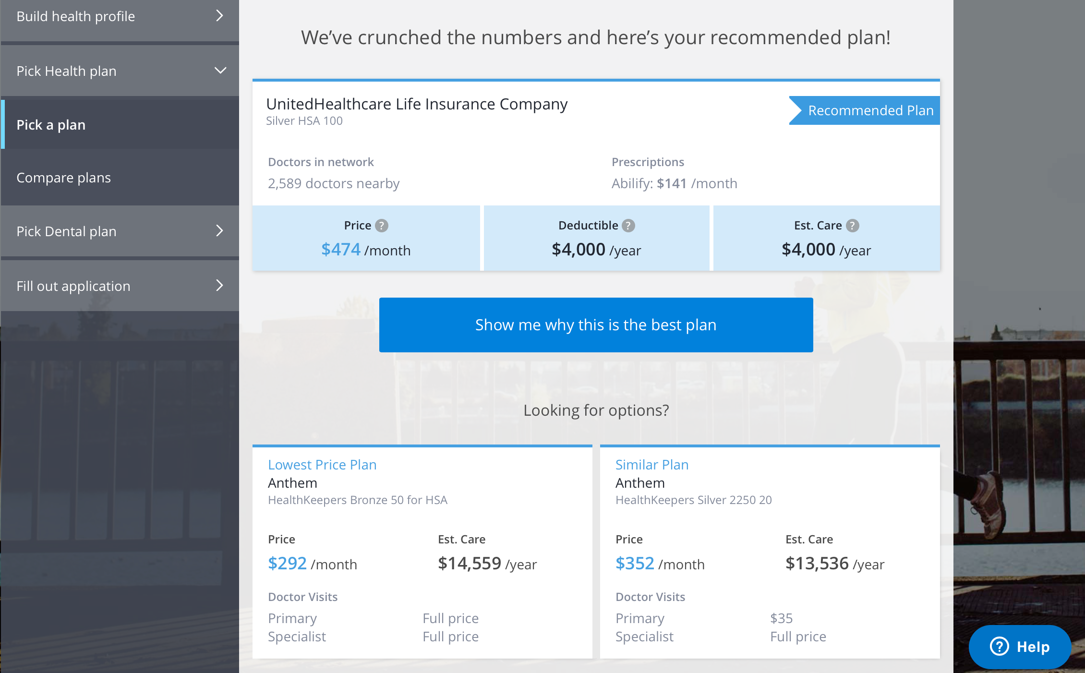
Innocent Bayes Standers
Are you interested in the following care?
About your care
Search
Build Health Profile>
Location
Clinical Trials
Location
Friendly United HC Silver
complete
Basic Info
complete
At home physical therapy : Acupuncture : Sleep Hygiene Lab
Doctors
Acupuncture
complete
Zip Code
Drugs
complete
Salary
Filter results by
Co-Pay
Annual Cost
Distance
Subscriber Popularity
At home Physical Therapy
Conditions
complete
Plan data
Correlations
Savings
Marital Status
complete
Meditation
Show me more
Care Directives
Single
Married
Divorced
Add
Number of dependents
Holistic Health
Trending:
Physician 1
Type II Diabetes Prevention
Physician 2
Ergonomics Class
Occupational Therapy
Preference options
Condition 1
Smoking Cessation
Medication 1

Slide 16
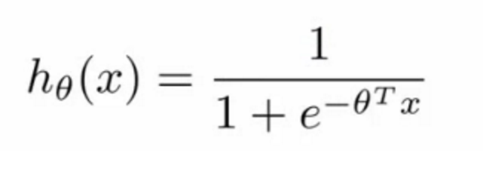
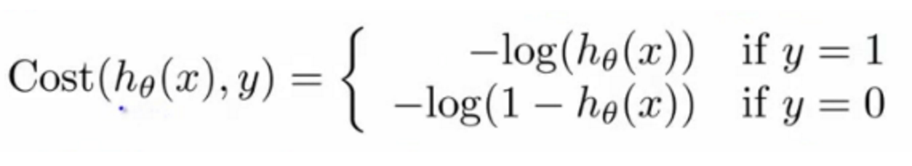
Click Behavior Tracking
Learn To Rank - LETOR
Use, for example, a logistic regression model to predict the probability that a Plan Y is the best result for a Query X
Plan A
Plan B
Income
67345
Show Results for:
Single
LETOR
Family?
Individual
Family
Holistic
Question
X
Question
Dr. Jimi
Question
Question
X
Dr. Shanahan
Question
X
Question
Intake Data Form
Pr(Y | x, θ ) =
Solve for model parameters θ by minimizing the Cost function:
Elasticsearch
Cluster

Slide 17
Next steps …
LETOR
ASR
Ranking
Model
Semantic
query
Behavioral data
SPARK + ES
ES
LOGS
Plan Result
Behavioral data

Slide 18





Next steps …
Pr(Y | x, θ ) =
LETOR
Behavioral data
ASR
Ranking
Model
Semantic
query
SPARK + ES
ES
LOGS
Plan Result
Behavioral data
Snowplow

Slide 19
Next Steps to MVP
Develop a chatbot to integrate into Obamacare
Build upon Auto Speech Recognition
Nuance Speech recognition
Natural Language Processing
Alyien
Elasticsearch buildout
Ranking Function – LETOR

Slide 20
Thank you!

Slide 21
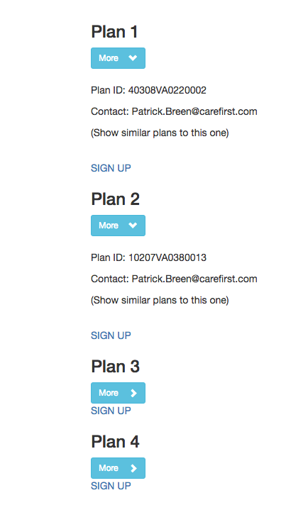
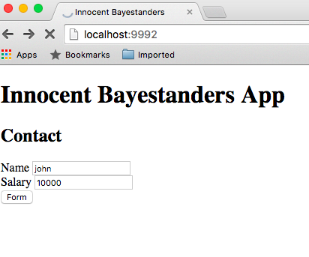
Brief Demo

Slide 22
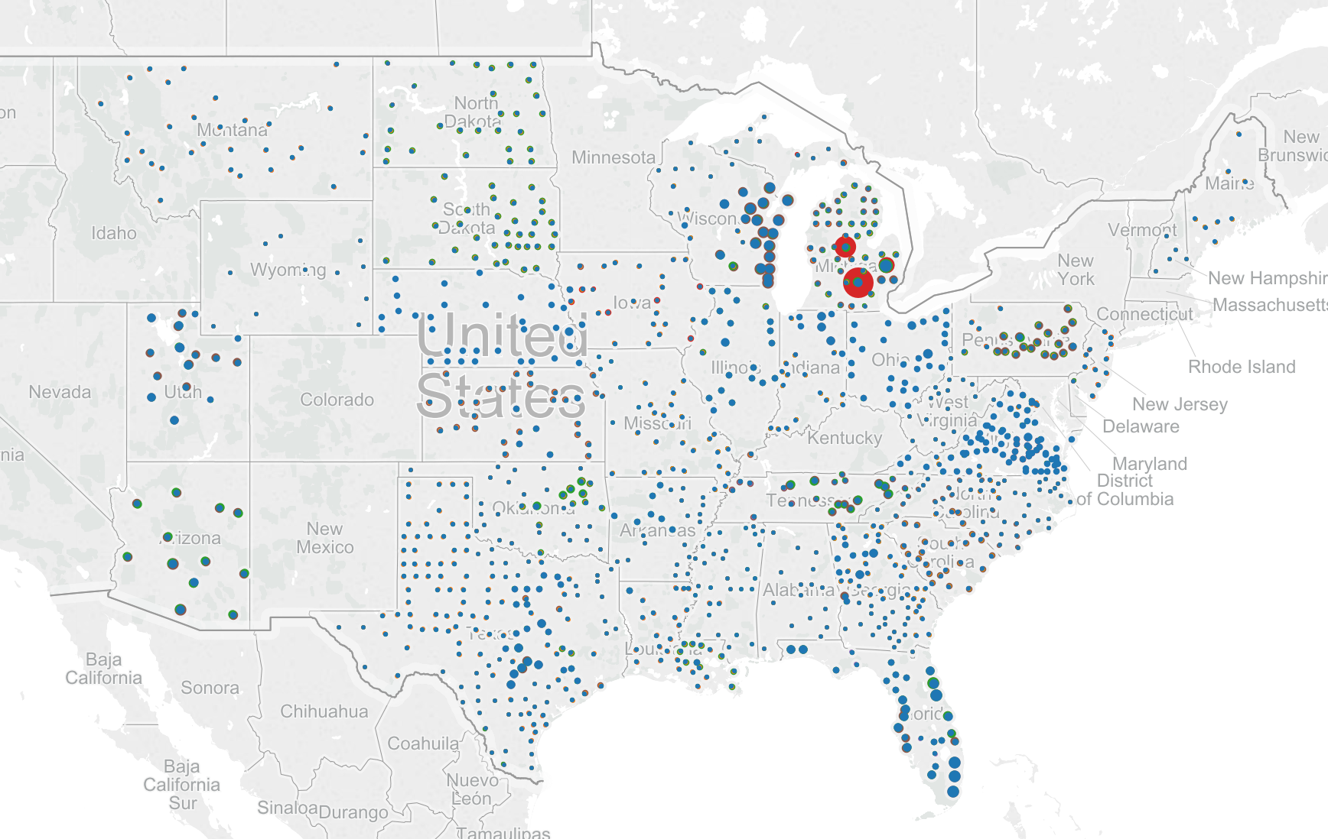
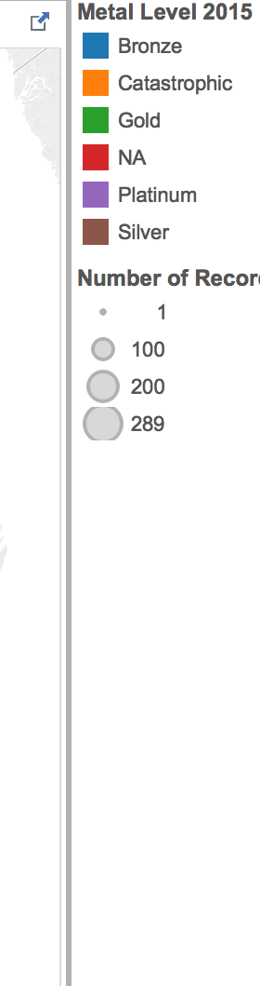
Most states have the same type of plan

Slide 23
Faceted Search Summary
Help more people navigate confusing plan info
- Go beyond “lowest cost plan” with physician restriction
Better provider matchup
- Users can be matched with plans service better accommodating factors
Learn behind the scenes from user behavior incentivized by facets

